Slide 1


Slide 2

bKash
Name:Shuvessa Howlader
Batch:20th
Roll:
Date:04/10/2024

Slide 3

What is bKash?
bKash is a mobile financial service (MFS) provider in Bangladesh that allows users to perform a variety of financial transactions through their mobile phones. Established in 2010, it is a subsidiary of BRAC Bank and operates under the approval of the Bangladesh Bank.

Slide 4

Services of bKash:
Send money
Cash in & Cash out
Mobile recharge
Payment services
Bill payments
Send Money
Remittance
Loan Services
Donation

Slide 5
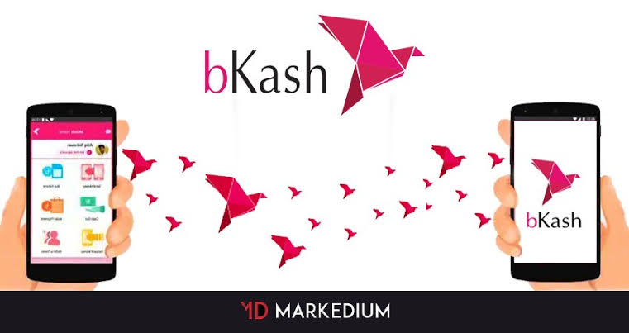
Market value of bKash:
MFS Services | 5year Historical CAGR | 5Year Forecast CAGR
Cash-In transaction | 29.7% | 13.7%
Cash-out transaction | 31.9% | 11.2%

Slide 6
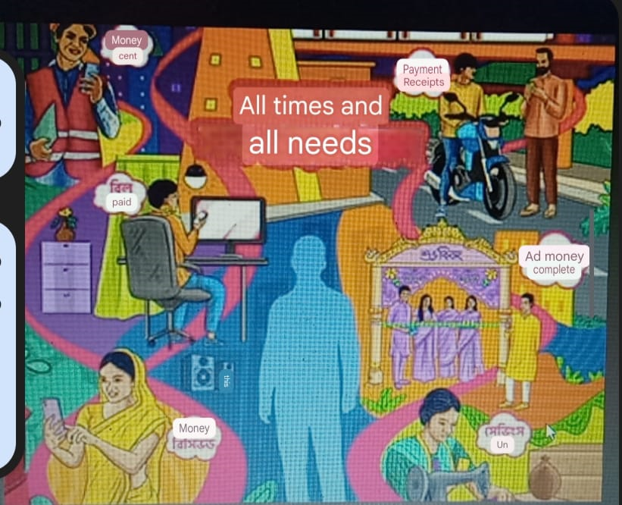
Conclution:
In Bangladesh,mobile financial services have got its popularity very recently
.bKashABkash is the most influencing organization behind this popularity.

Slide 7


